Slide 1
Cars Machine Learning Journey
Data Maverick team deep dive –
Riicha Mohan
Deepa Karnani
Ira Buchberger
Roderick Jean

Slide 2
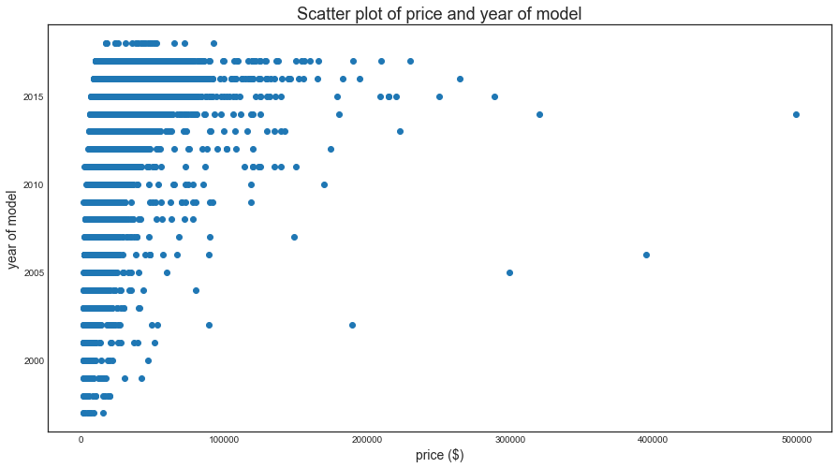
Scatter Plot of Price and Year of Model

Slide 3
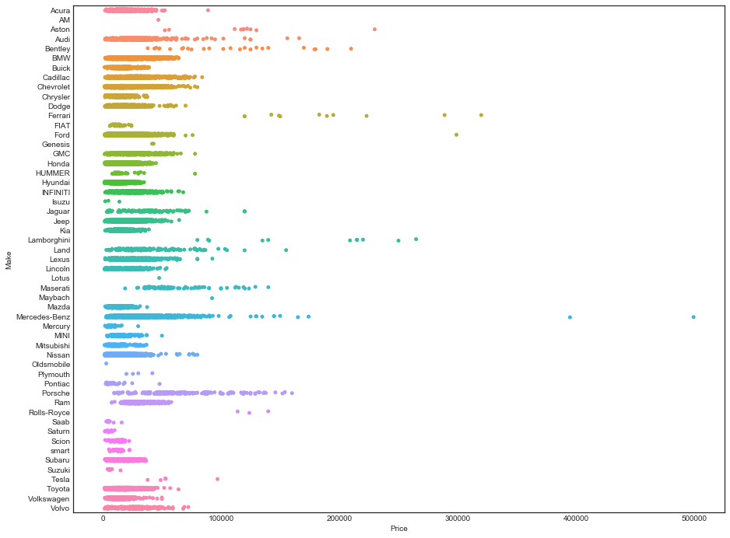
Willing to pay the right price?

Slide 4
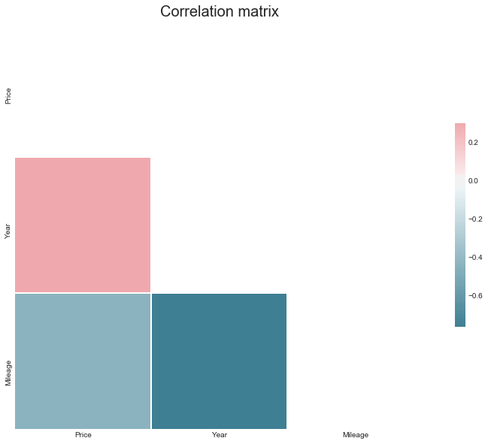
Correlation Matrix – Fits Machine Learning

Slide 5
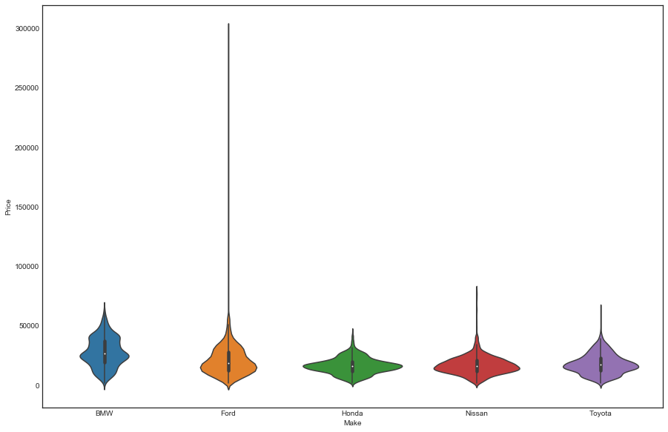
BMW & Ford are apart from Japanese

Slide 6
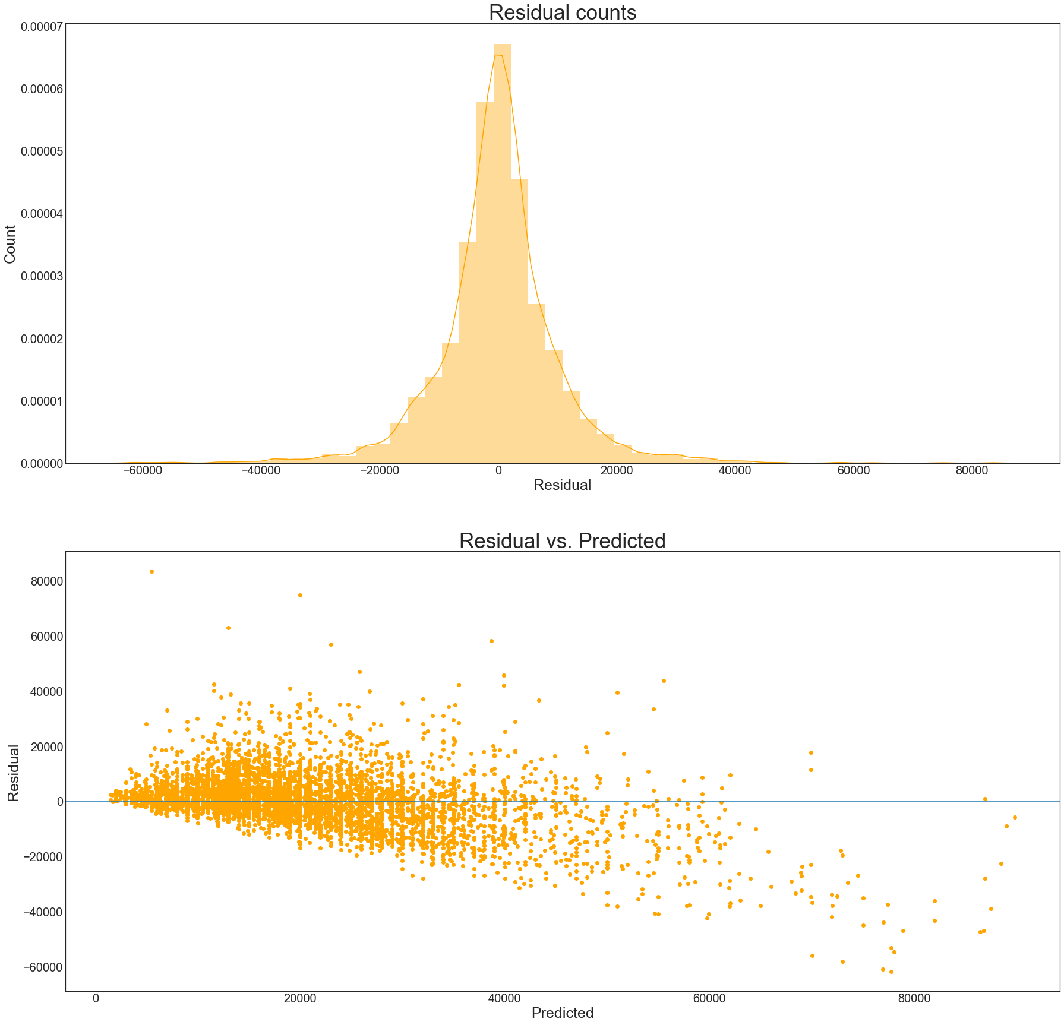
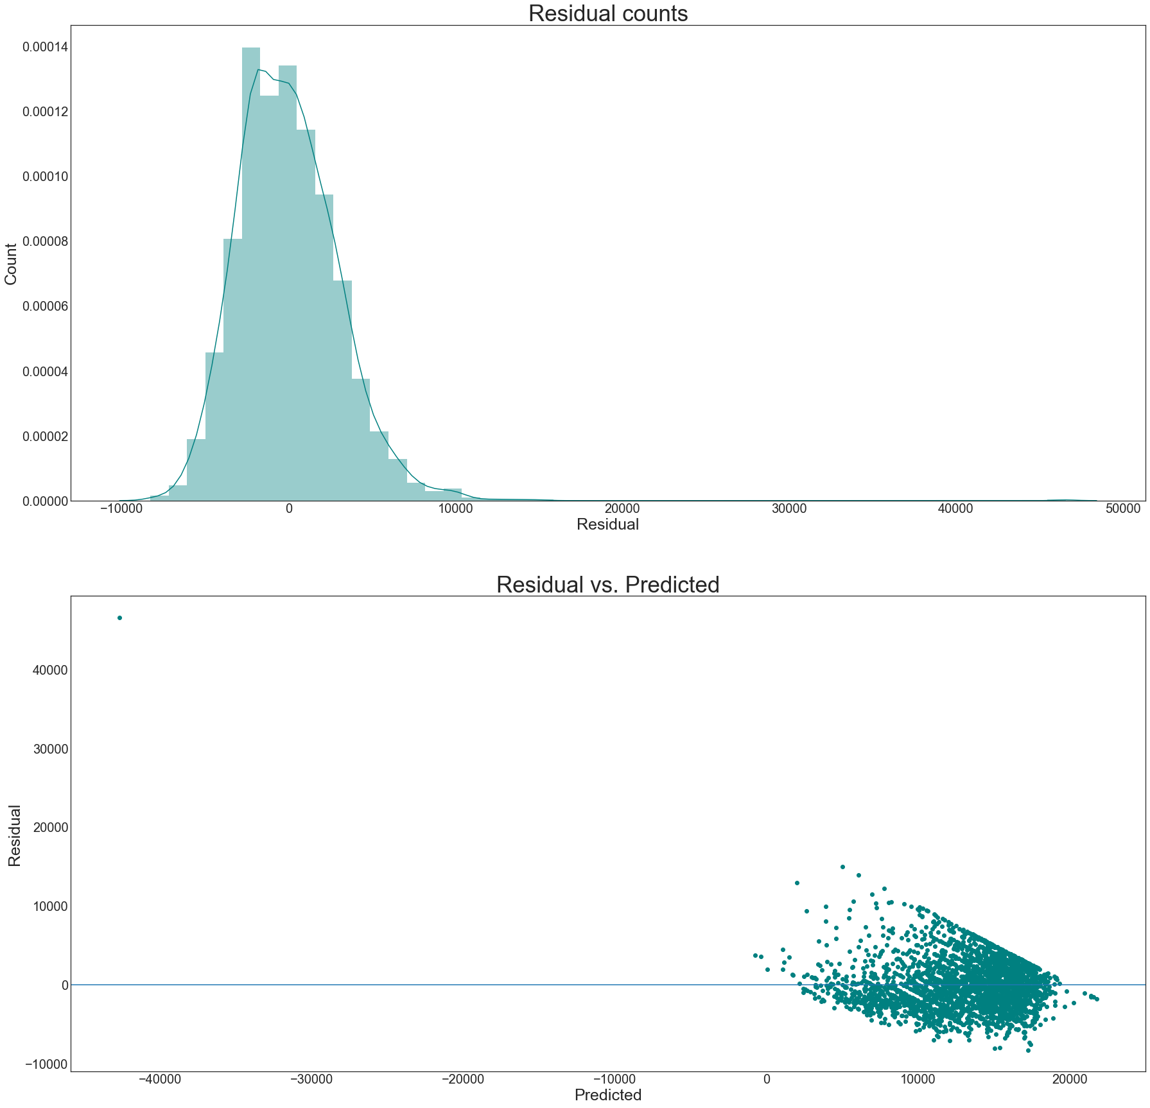
Decision Tree Vs Linear Regression

Slide 7
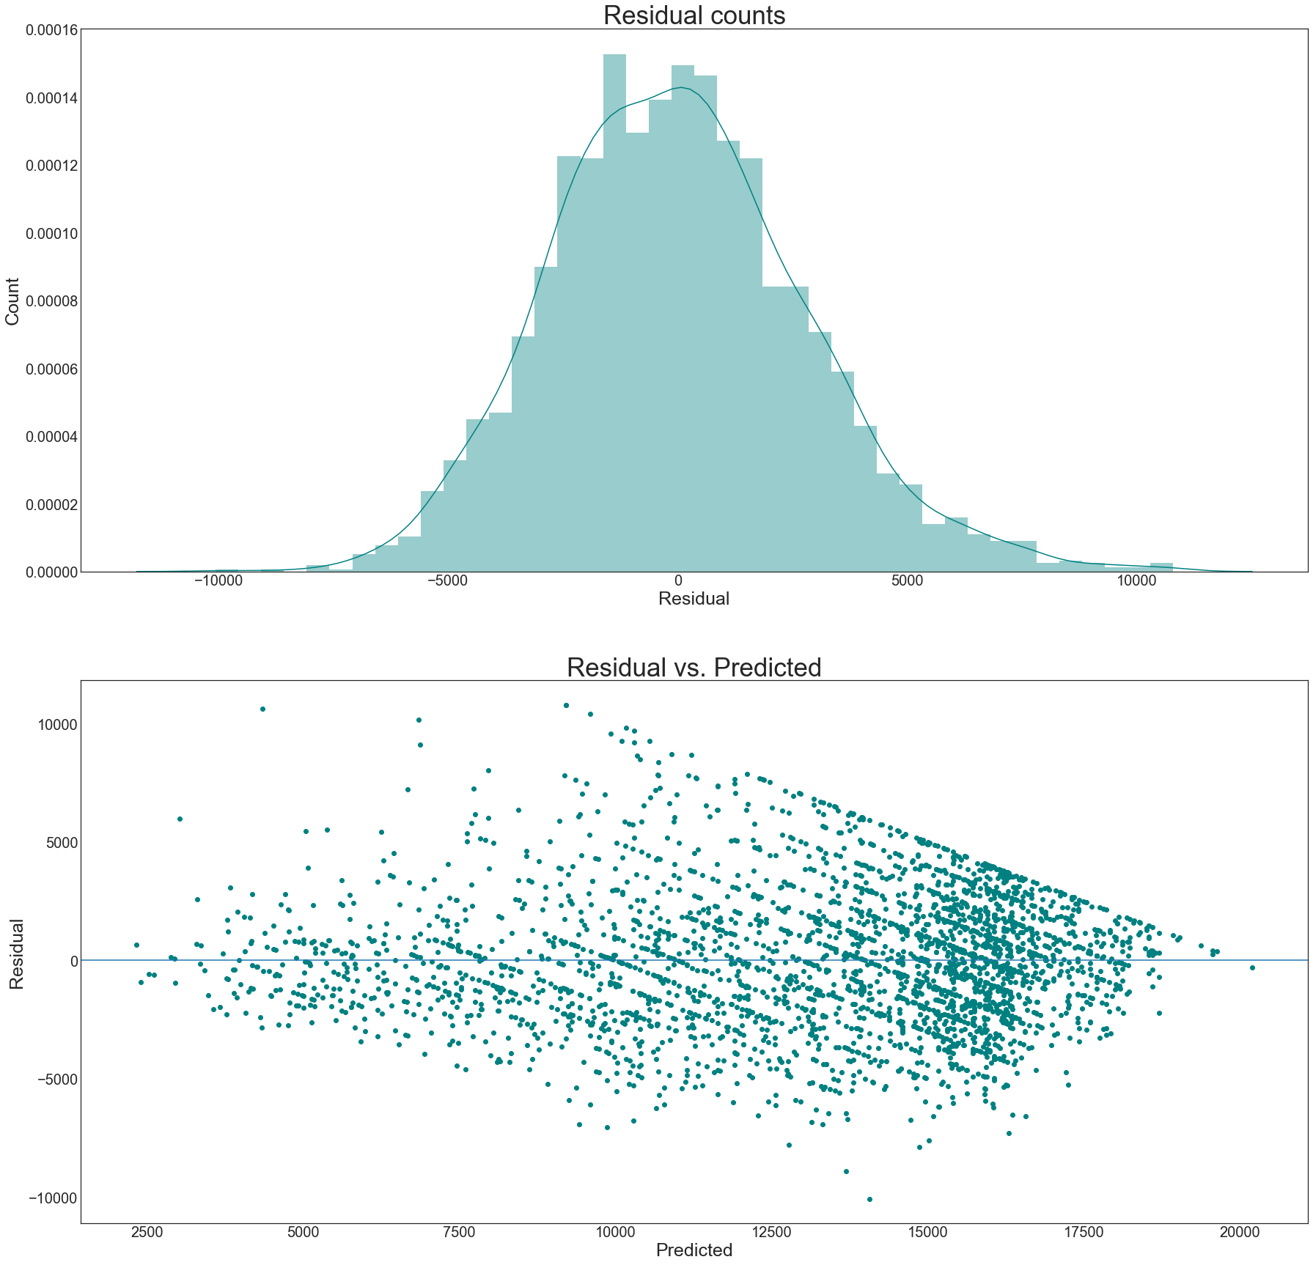
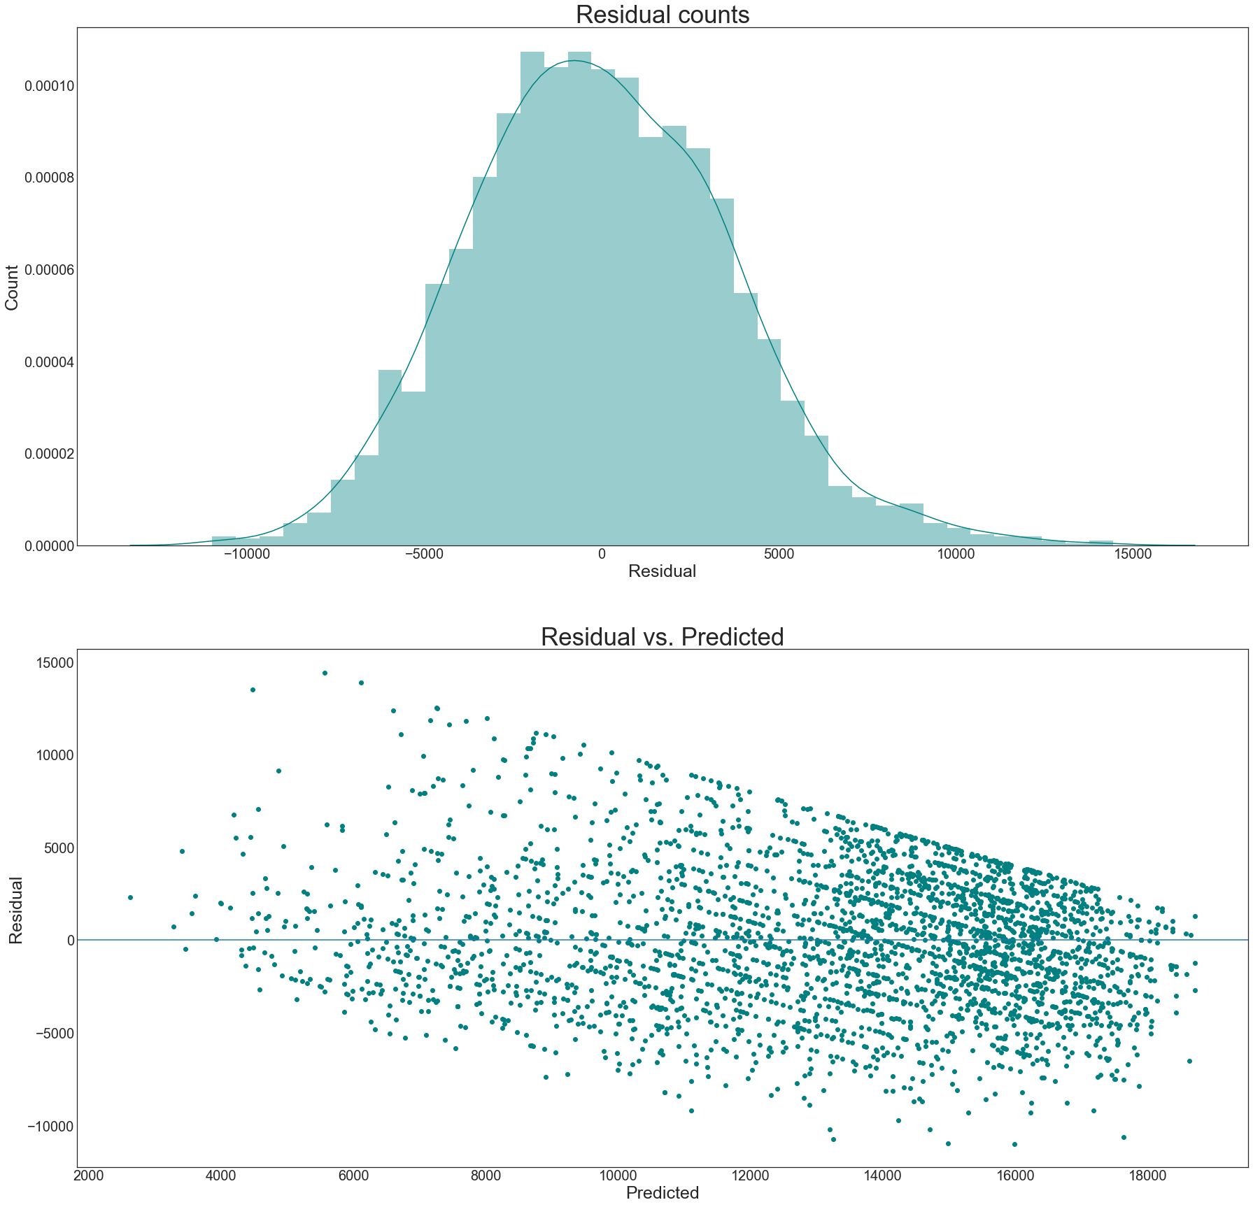
Before and after Gradient Boosting

Slide 8
Gradient Boosting
Boosting is a machine learning ensemble meta-algorithm for primarily reducing bias, and also variance in supervised learning, and a family of machine learning algorithms which convert weak learners to strong ones. Boosting is based on the question posed by Kearns and Valiant (1988, 1989):
Can a set of weak learners create a single strong learner? A weak learner is defined to be a classifier which is only slightly correlated with the true classification (it can label examples better than random guessing). In contrast, a strong learner is a classifier that is arbitrarily well-correlated with the true classification. ~ WikiPedia) Let's see if boosting can improve our scores.

Slide 9
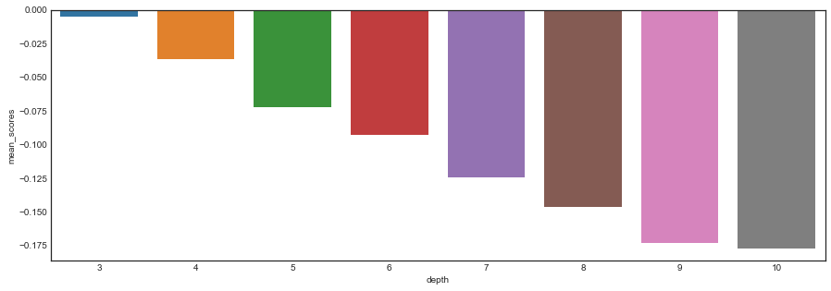
Depth vs Mean Scores

Slide 10
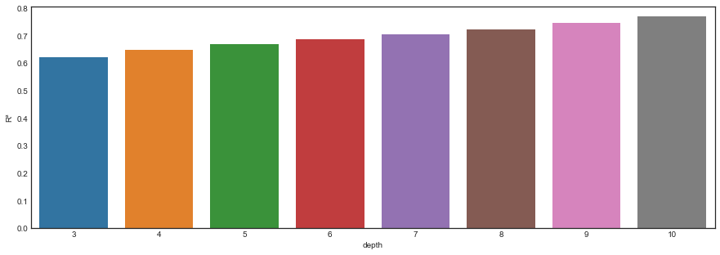
Depth and R²

Slide 11
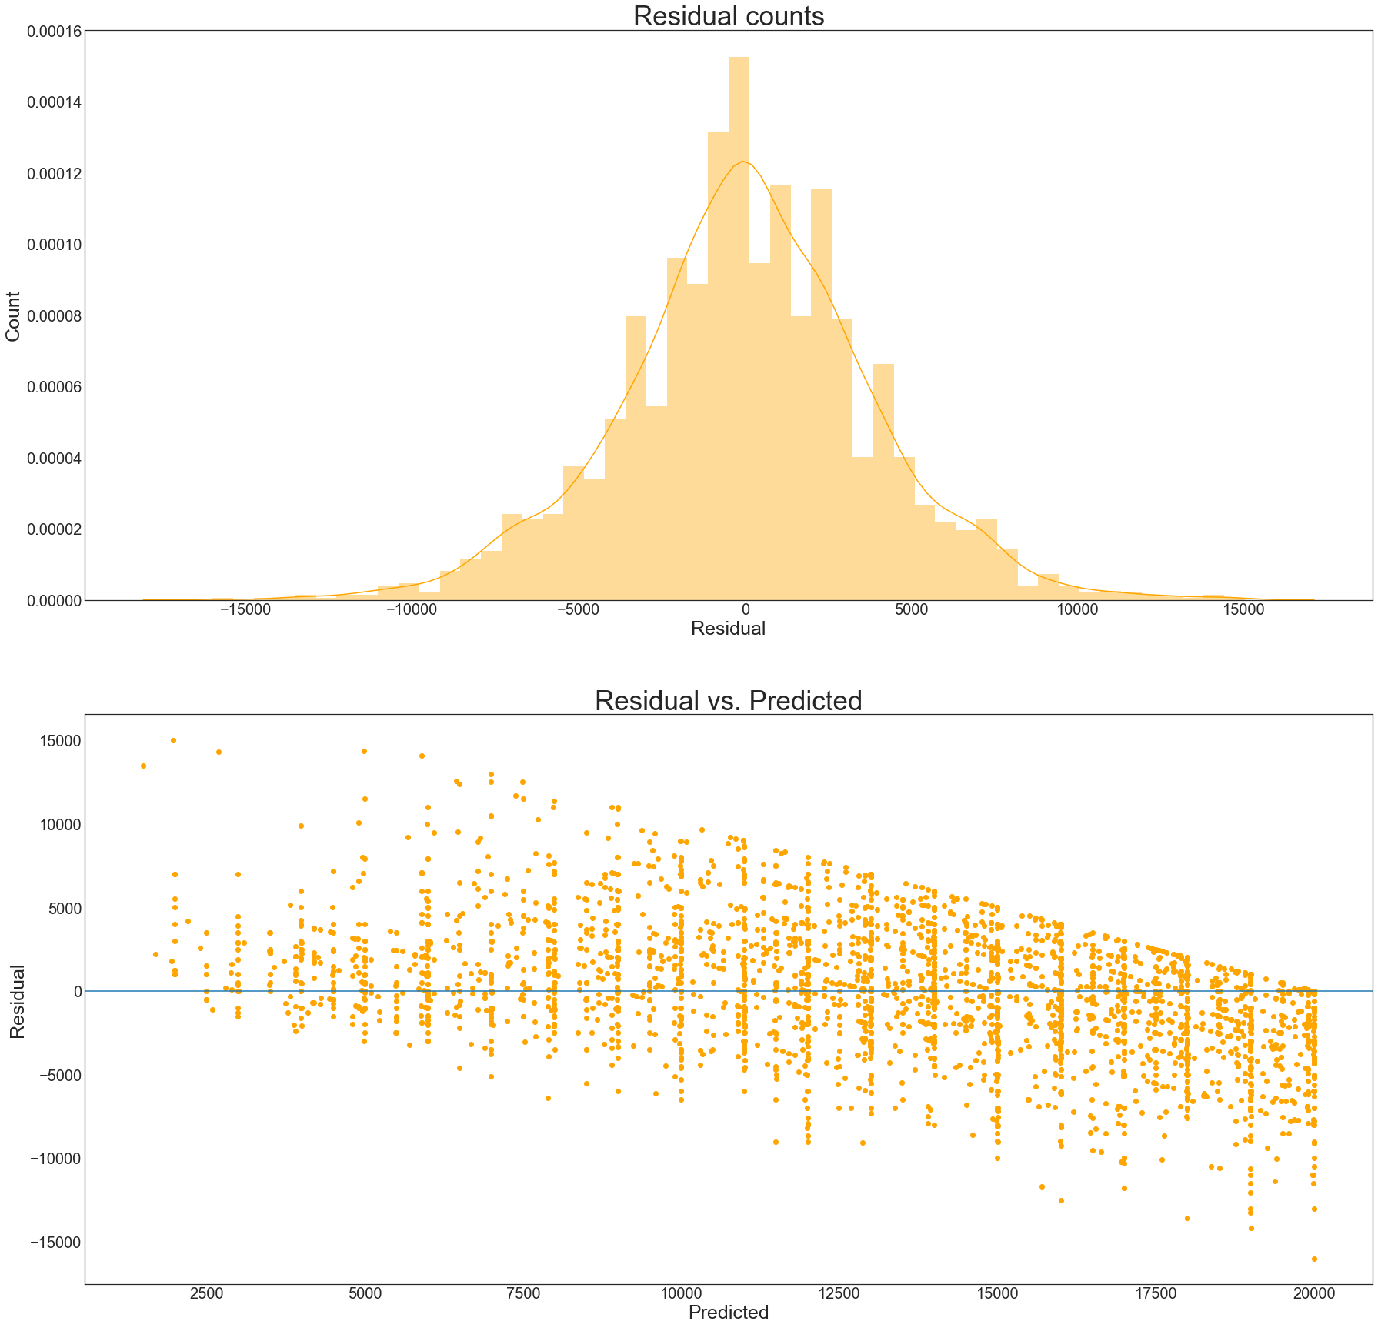
kNN application delivers lower rsme

Slide 12
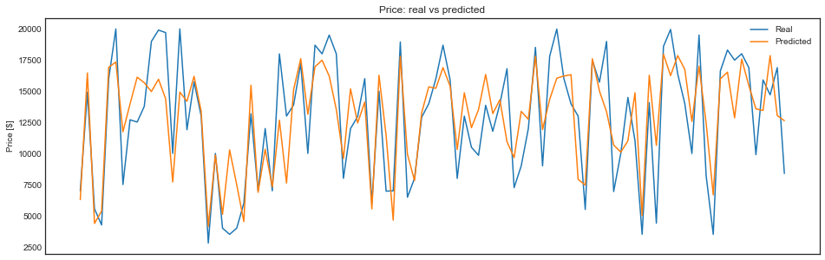
Trained and tested..

Slide 13
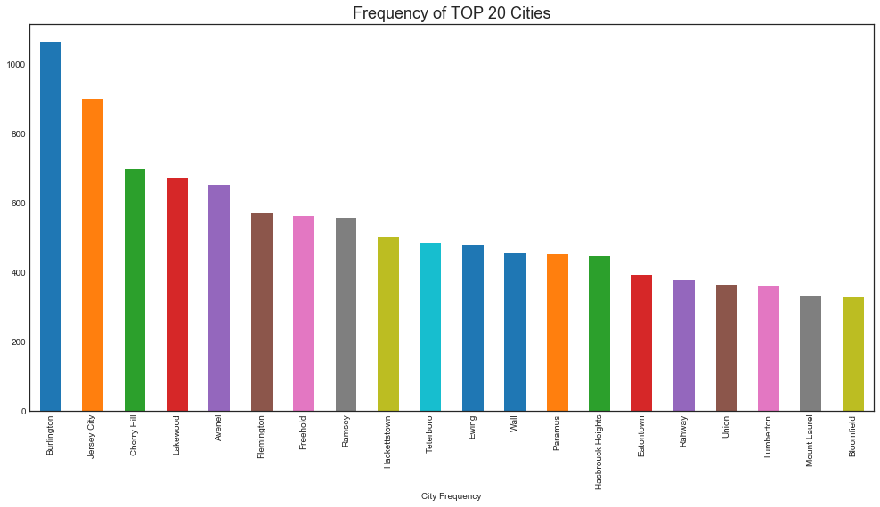
NJ’s top 20 cities with Cars inventory distribution

Slide 14
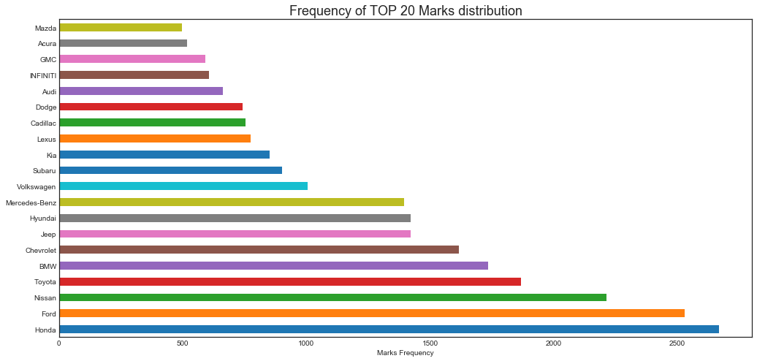
Top 20 cars!

Slide 15
RMSE Scores
Model | Variance Score | RMSE
KNN | 0.56 | 37709.67
Multiple Linear Regression | 0.62 | 34865.07
Gradient Boosting | 0.80 | 25176.16
Decision Tree | 0.63 | 34551.17

